Slide 1
DATABASE MANAGEMENT SYSTEMS
Subject Teacher: Junaid Javed Korai

Slide 2
DATABASE DEVELOPMENT PROCESS
Lecture # 3
Disclaimer: The material used in this presentation to deliver the lecture i.e., definitions/text and pictures/graphs etc. does not solely belong to the author/presenter. The presenter has gathered this lecture material from various sources on web/textbooks. Following sources are especially acknowledged:
Connolly, Thomas M., and Carolyn E. Begg. Database systems: a practical approach to design, implementation, and management. Pearson Education, 2005.
2. Hoffer, Jeffrey A.,Venkataraman Ramesh, and Heikki Topi. Modern database management. Upper Saddle River, NJ: Prentice Hall,, 2011.
2

Slide 3
IN THIS LECTURE YOU WILL LEARN ABOUT:
Database Development Process
System Development Life Cycle
Prototyping Database Methodology

Slide 4
DATABASE DEVELOPMENT PROCESS
It is the subdivision of the development process into a series of phases, or steps, each of which focuses on one aspect of the development.
The collection of these steps is sometimes referred to as a System Development Life Cycle (SDLC).
The SDLC is a complete set of steps that a team of information systems professionals, including database designers and programmers follow in an organization to specify, develop, maintain and replace information systems.
4

Slide 5

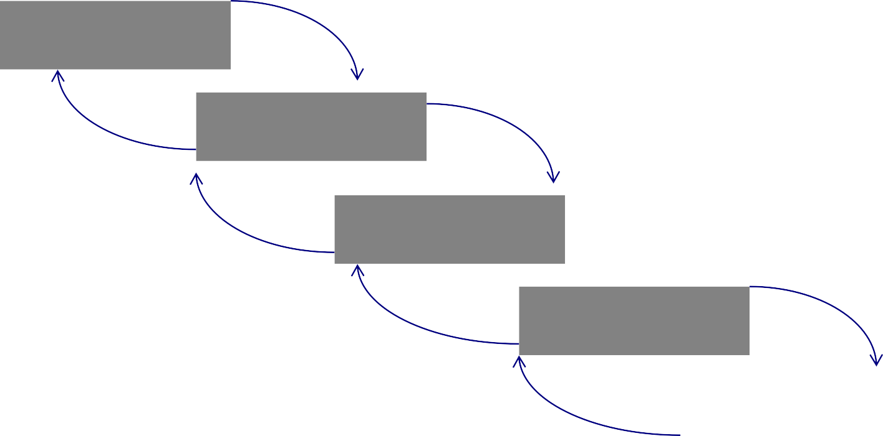
SYSTEMS DEVELOPMENT LIFE CYCLE (CONT.)
Planning
Analysis
Logical Design
Physical Design
Implementation
Maintenance
5

Slide 6


SYSTEMS DEVELOPMENT LIFE CYCLE (CONT.)
Planning
Purpose–preliminary understanding
Deliverable–request for study
Analysis
Logical Design
Physical Design
Database activity– enterprise modeling and early conceptual data modeling
Implementation
Maintenance
6

Slide 7

SYSTEMS DEVELOPMENT LIFE CYCLE (CONT.)
Planning
Purpose–thorough requirements analysis and
structuring
Deliverable–functional system specifications
Analysis
Analysis
Logical Design
Physical Design
Database activity–Thorough and integrated conceptual data modeling
Implementation
Maintenance
7

Slide 8
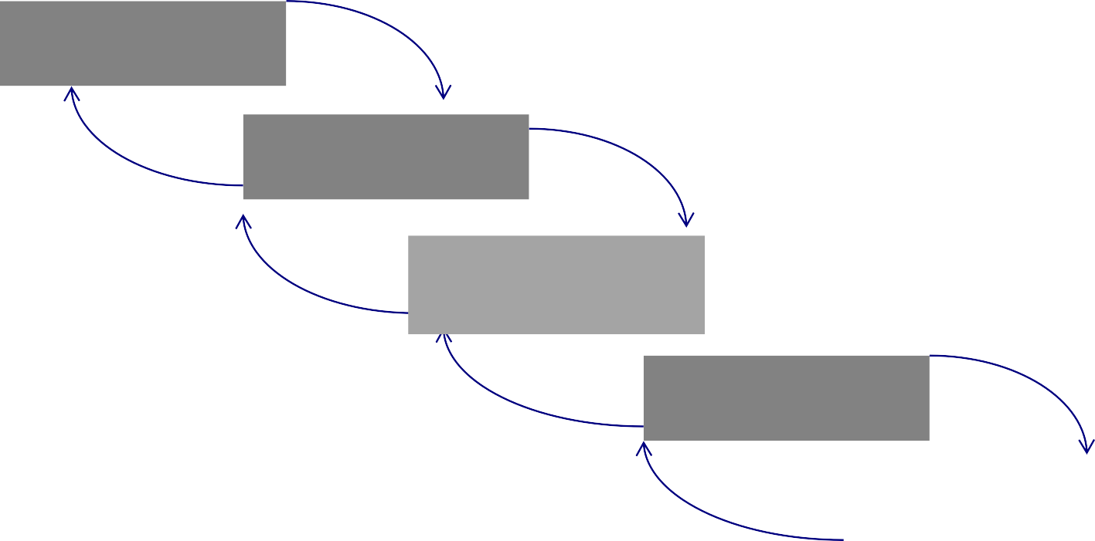
SYSTEMS DEVELOPMENT LIFE CYCLE (CONT.)
Planning
Purpose–information requirements elicitation
and structure
Deliverable–detailed design specifications
Analysis
Logical Design
Physical Design
Database activity– logical database design (transactions, forms, displays, views, data integrity and security)
Implementation
Maintenance
8

Slide 9
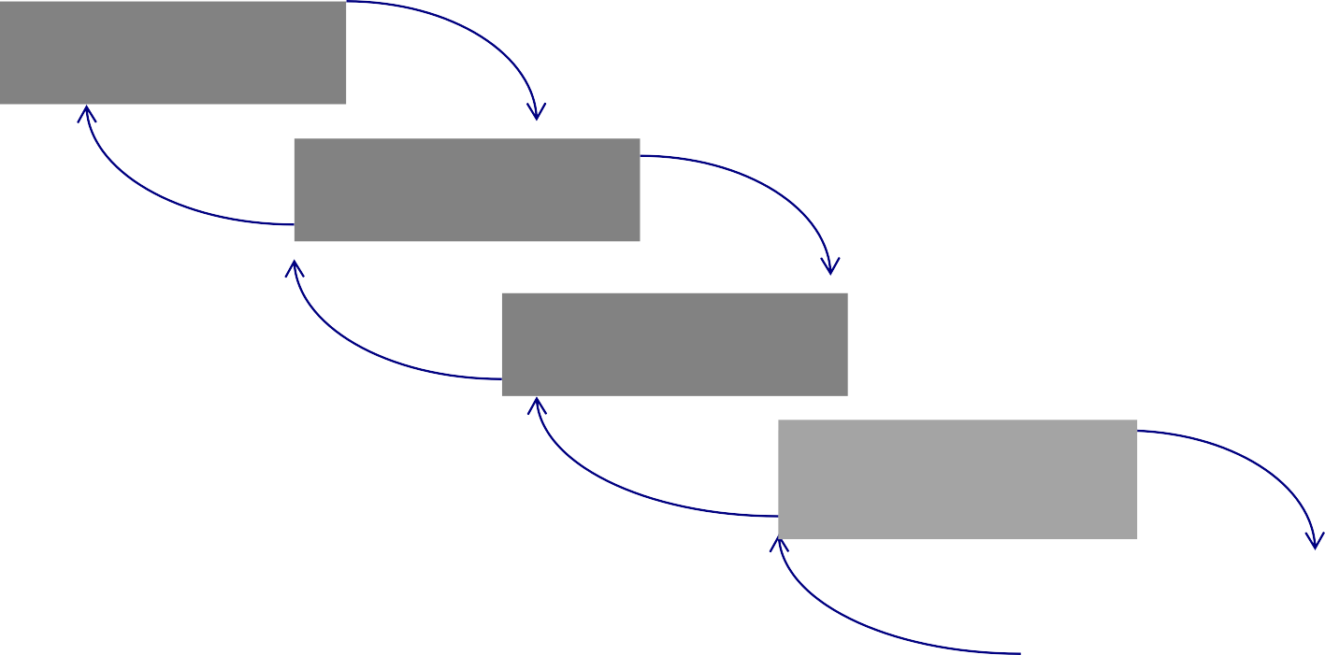
SYSTEMS DEVELOPMENT LIFE CYCLE (CONT.)
Purpose–develop technology and organizational specifications Deliverable–program/data structures, technology purchases, organization redesigns
Planning
Analysis
Logical Design
Physical Design
Physical Design
Database activity–
physical database design (define database to DBMS, physical data organization, database processing programs)
Implementation
Maintenance
9

Slide 10
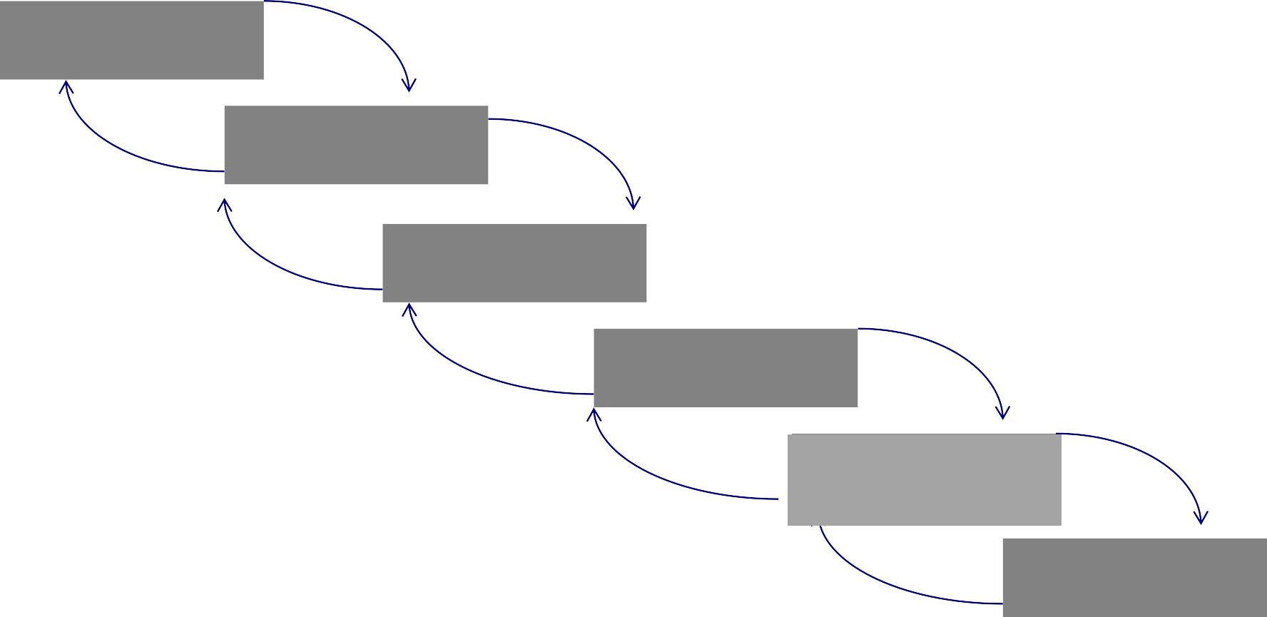
SYSTEMS DEVELOPMENT LIFE CYCLE (CONT.)
Purpose–programming, testing, training, installation, documenting Deliverable–operational programs, documentation, training materials
Planning
Analysis
Logical Design
Physical Design
Database activity– database implementation, including coded programs, documentation, installation and conversion
Implementation
Implementation
Maintenance
10

Slide 11
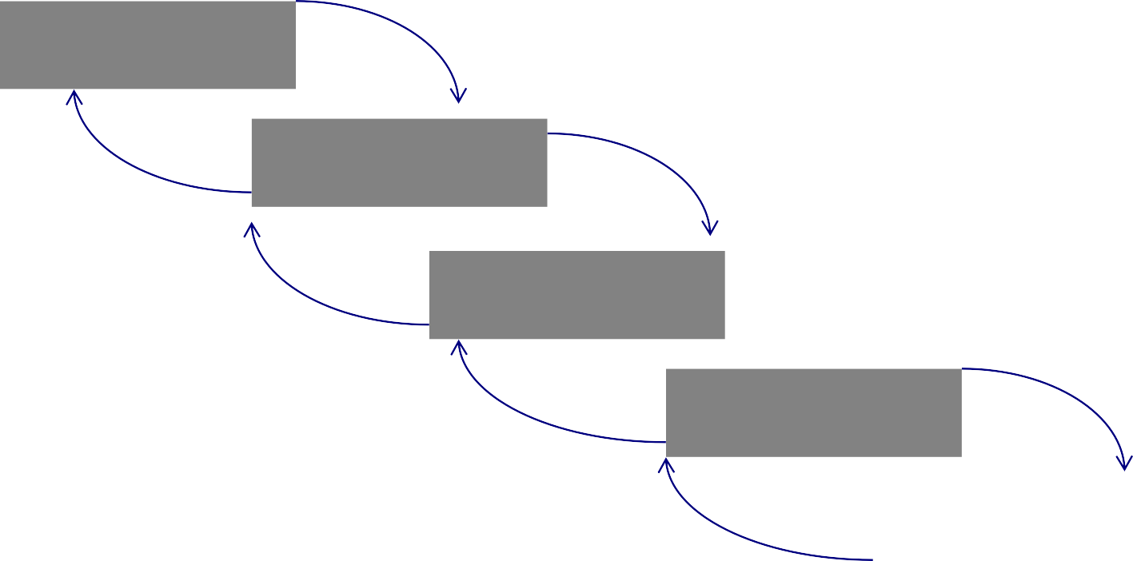
SYSTEMS DEVELOPMENT LIFE CYCLE (CONT.)
Planning
Purpose–monitor, repair, enhance Deliverable–periodic audits
Analysis
Logical Design
Physical Design
Database activity– database maintenance, performance analysis and tuning, error corrections
Implementation
Maintenance
Maintenance
11

Slide 12

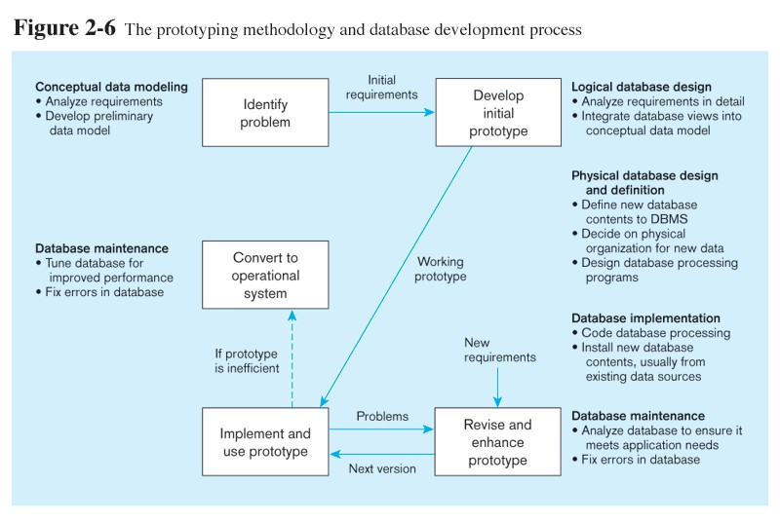
Prototyping Database Methodology
12

Slide 13
Prototyping Database Methodology
13

Slide 14
Prototyping Database Methodology

Slide 15
Prototyping Database Methodology

Slide 16
Prototyping Database Methodology

